Slide 1

Project Proposal: Airbnb
Presented By: Sai Arvind, Bhavigna V, Amandeep, Elias Kattes

Slide 2


Problem Statement
The hospitality industry is growing with peer-to-peer rentals, as guests seek unique, affordable stays and owners monetize empty properties.
However, there's a need for platforms that enhance trust and user experience for both hosts and guests.
Leveraging user data can improve booking processes and foster a community of reliable hosts and satisfied guests.

Slide 3
How the proposed Database will address the problem
Property Recommendations
Transparency and trust
Loyalty Programs
By collecting visitor preferences and feedback, the platform may provide customized property recommendations, boosting the user experience.
The feedback and rating system will encourage trust.
Loyalty programs provide discounts or rewards to repeat users.
Super host Recognition
Dynamic Pricing
Secure Transactions
Recognize and reward top-performing hosts, encouraging them to keep up their high standards.
The PricePerNight attribute can be changed based on occupancy rate, allowing hosts to create revenue-maximizing dynamic pricing methods.
Payment entity makes certain that all transactions are recorded, resulting in a secure and transparent payment process

Slide 4



Key Entities
Users
Listings/Properties
Reservations
The app has different types of users like Guest, Hosts etc. with different privileges.
Listings are created by Hosts to showcase their services. It contains title, description, photos, price etc.
Guests can book/reserve listings by creating a reservation. It tracks reservation status, dates etc.
Defining the key entities like Users, Listings and Reservations will provide clarity on the core objects that the system needs to manage.

Slide 5

ER DIAGRAM

Slide 6
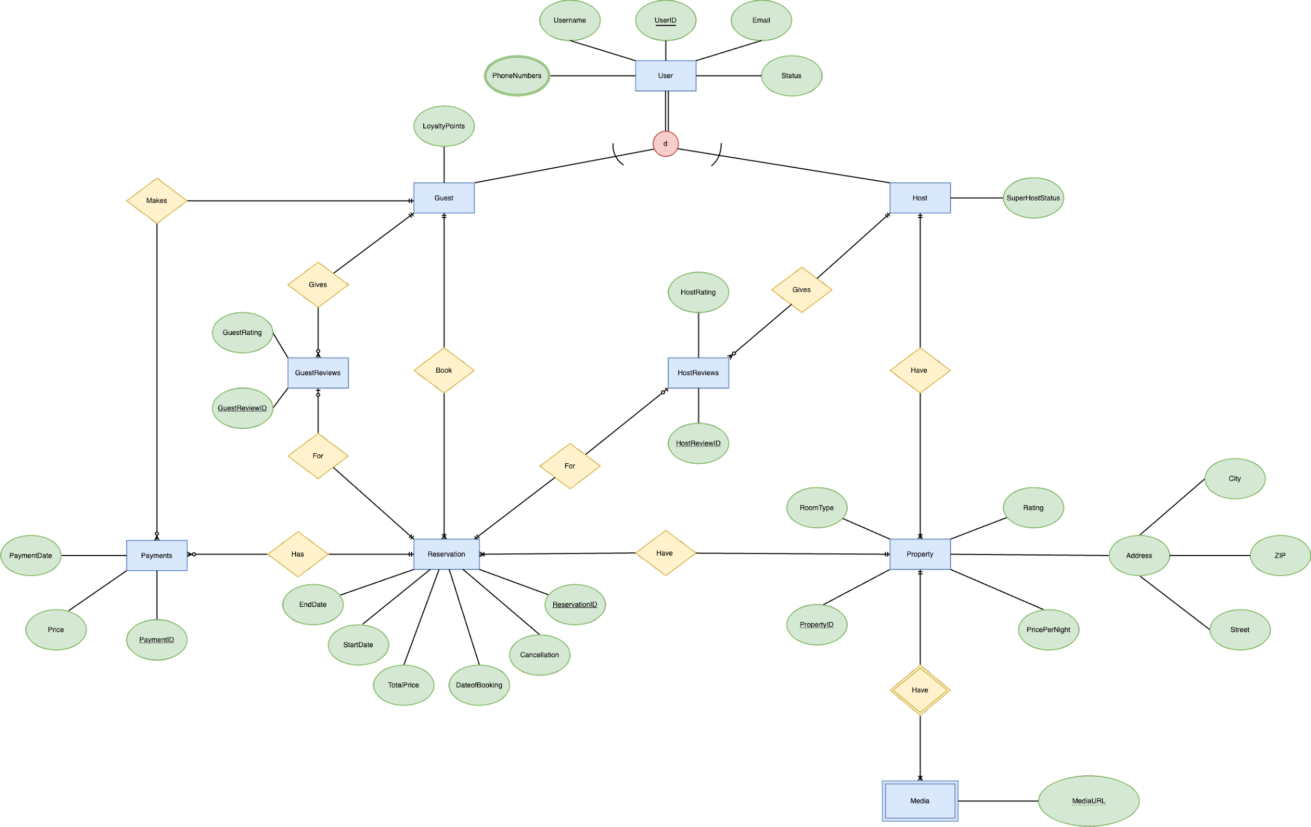

Slide 7
Part 1 of
ER
Diagram
User (Superclass):
Attributes: UserID, Username, Email, DateofJoining, PhoneNumbers.
Relationships: A User can be either a Guest or a Host, but not both.
Justification: The User entity acts as a superclass to capture common attributes and behaviors of both Guests and Hosts. This design promotes data integrity and reduces redundancy.
a) Guest (Subclass of User):
Attributes: Preferences, Loyalty Points.
Relationships: A Guest can make multiple Reservations, make payments, and can give a Guest Review.
Justification: By creating a Guest subclass, specific attributes and behaviors related to guests are captured.
b) Host (Subclass of User):
Attributes: SuperhostStatus.
Relationships: A Host can list multiple listings/properties and post a HostReview.
Justification: The Host subclass captures attributes and behaviors specific to hosts. The SuperhostStatus can be used to offer special privileges or promotions to superhosts.

Slide 8
Reservation:
Attributes: ReservationID, StartDate, EndDate, TotalPrice, Cancellation, DateofBooking.
Relationships: A Reservation is an agreement between a Guest and a Listing.
Justification: The Reservation entity captures the details of a booking. By linking it with UserID and PropertyID, it ensures that each reservation is associated with a guest and a property.
GuestReviews:
Attributes: GuestReviewID, GuestRating
Justification: The GuestReviews entity allows guests to provide ratings for listings, which can be useful for future guests and for hosts to improve their services.
Part 2 of
ER
Diagram

Slide 9
Listing / Property:
Attributes: PropertyID, Address, RoomType.
Relationships: A property is owned by one Host and each property will have Media.
Justification: The property entity captures all details about properties available for reservation. The UserID as a foreign key ensures that each listing is associated with a host.
HostReviews:
Attributes: HostReviewID, HostRating
Justification: The Host Reviews entity captures feedback specifically about the guest's behavior during their stay.
Part 3 of
ER
Diagram

Slide 10
Relational Schema

Slide 11
Relational Schema Mapping
A.) USER (UserID, Username, Email, Status)
PHONENUMBERS (PhoneNumber, UserID [FK])
B.) GUEST (LoyaltyPoints, Guest_UserID [FK])
C.) HOST (SuperHostStatus, Host_UserID [FK])
D.) PROPERTY (PropertyID, RoomType, Rating, Price, Street, City, ZIP, Hosts_UserID [FK])
E.) MEDIA (MediaURL, PropertyID [FK])
F.) RESERVATION (ReservationID, DateofBooking, StartDate, EndDate, TotalPrice, Cancellation, Guest_UserID [FK], PropertyID [FK])
G.) HOSTREVIEWS (HostReviewID, HostRating, Host_UserID [FK], ReservationID [FK])
H.) GUESTREVIEWS (GuestReviewID, GuestRating, Guest_UserID [FK], ReservationID [FK])
I.) PAYMENTS (PaymentID, PaymentDate, Price, Guest_UserID [FK], ReservationID [FK])

Slide 12


Relational Data Model
Tables
Relational Schema Explantion
USER
This table includes the UserID (primary key), Username, Email, and Status. It represents the basic user information
PHONENUMBERS
Contains PhoneNumber and a foreign key UserID referencing the USER table. This table stores the phone numbers of users
GUEST
Includes LoyaltyPoints and a foreign key Guest_UserID referencing the USER table. This table is for guests with additional attributes like loyalty points.
HOST
Consists of SuperHostStatus and a foreign key Host_UserID referencing the USER table. It's for hosts, especially those with superhost status
PROPERTY
This table has PropertyID (primary key), RoomType, Rating, Price, Street, City, ZIP, and a foreign key Hosts_UserID referencing the HOST table. It lists properties available for renting.
*Example data

Slide 13


Relational Data Model Continued...
Tables
Relational Schema Explanation
MEDIA
Contains MediaURL and a foreign key PropertyID referencing the PROPERTY table. This table stores media links related to properties
RESERVATION
Includes ReservationID (primary key), DateofBooking, StartDate, EndDate, TotalPrice, Cancellation, and foreign keys Guest_UserID (referencing GUEST) and PropertyID (referencing PROPERTY). It tracks reservations made by guests.
HOSTREVIEWS
Comprises HostReviewID (primary key), HostRating, and foreign keys Host_UserID (referencing HOST) and ReservationID (referencing RESERVATION). This table stores reviews of hosts
GUESTREVIEWS
Contains GuestReviewID (primary key), GuestRating, and foreign keys Guest_UserID (referencing GUEST) and ReservationID (referencing RESERVATION). It keeps track of reviews made by guests
PAYMENTS
Includes PaymentID (primary key), PaymentDate, Price, and foreign keys Guest_UserID (referencing GUEST) and ReservationID (referencing RESERVATION). This table records payment transactions.

Slide 14
SQL QUERIES

Slide 15
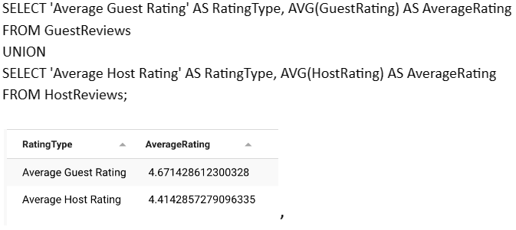
What are the average ratings for guests and hosts, and how do they compare to each other?
SQL QUERY 1
Query explanation:
This query is useful for assessing the overall performance and satisfaction levels of both guests and hosts. Utilizing the GuestReviews and HostReviews entities aligns with your goal of ensuring transparency and trust.

Slide 16
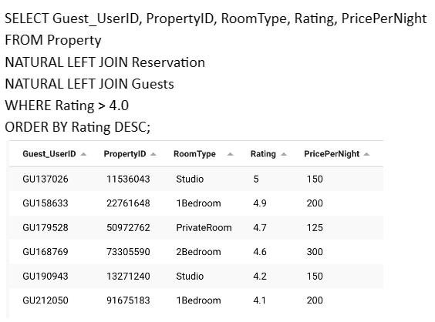
What are the properties with a rating greater than 4.0 that have been reserved by guests, and how are these properties categorized by room type and price per night?
SQL QUERY 2
Query explanation:
This query identifies properties with ratings greater than 4.0 and categorizes them according to room type and price per night. This is useful for guests seeking high-quality accommodations and aligns with your goal of making property recommendations based on guest preferences and feedback.

Slide 17
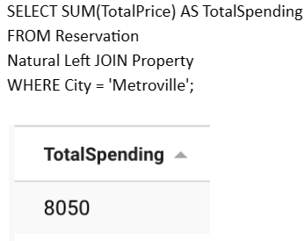
What is the total amount of money spent by all guests on accommodations in Metroville?
SQL QUERY 3
Query explanation:
This query offers a consolidated view of the money spent by visitors in Metroville. It aligns with your objective of understanding market trends and the financial performance in specific areas.

Slide 18
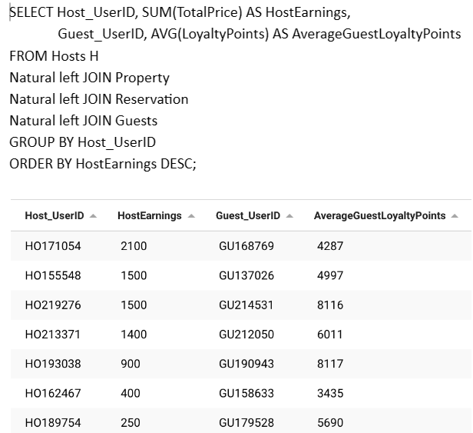
What are the total earnings of each host and the average loyalty points of guests who have stayed in their properties, and how do these earnings and guest loyalty points vary by host?
SQL QUERY 4
Query explanation:
This critical query helps in understanding the financial performance of hosts and the engagement of guests through loyalty points. It directly supports your goals of rewarding top-performing hosts and encouraging guest loyalty.

Slide 19
TABLEAU VISUALIZATION

Slide 20
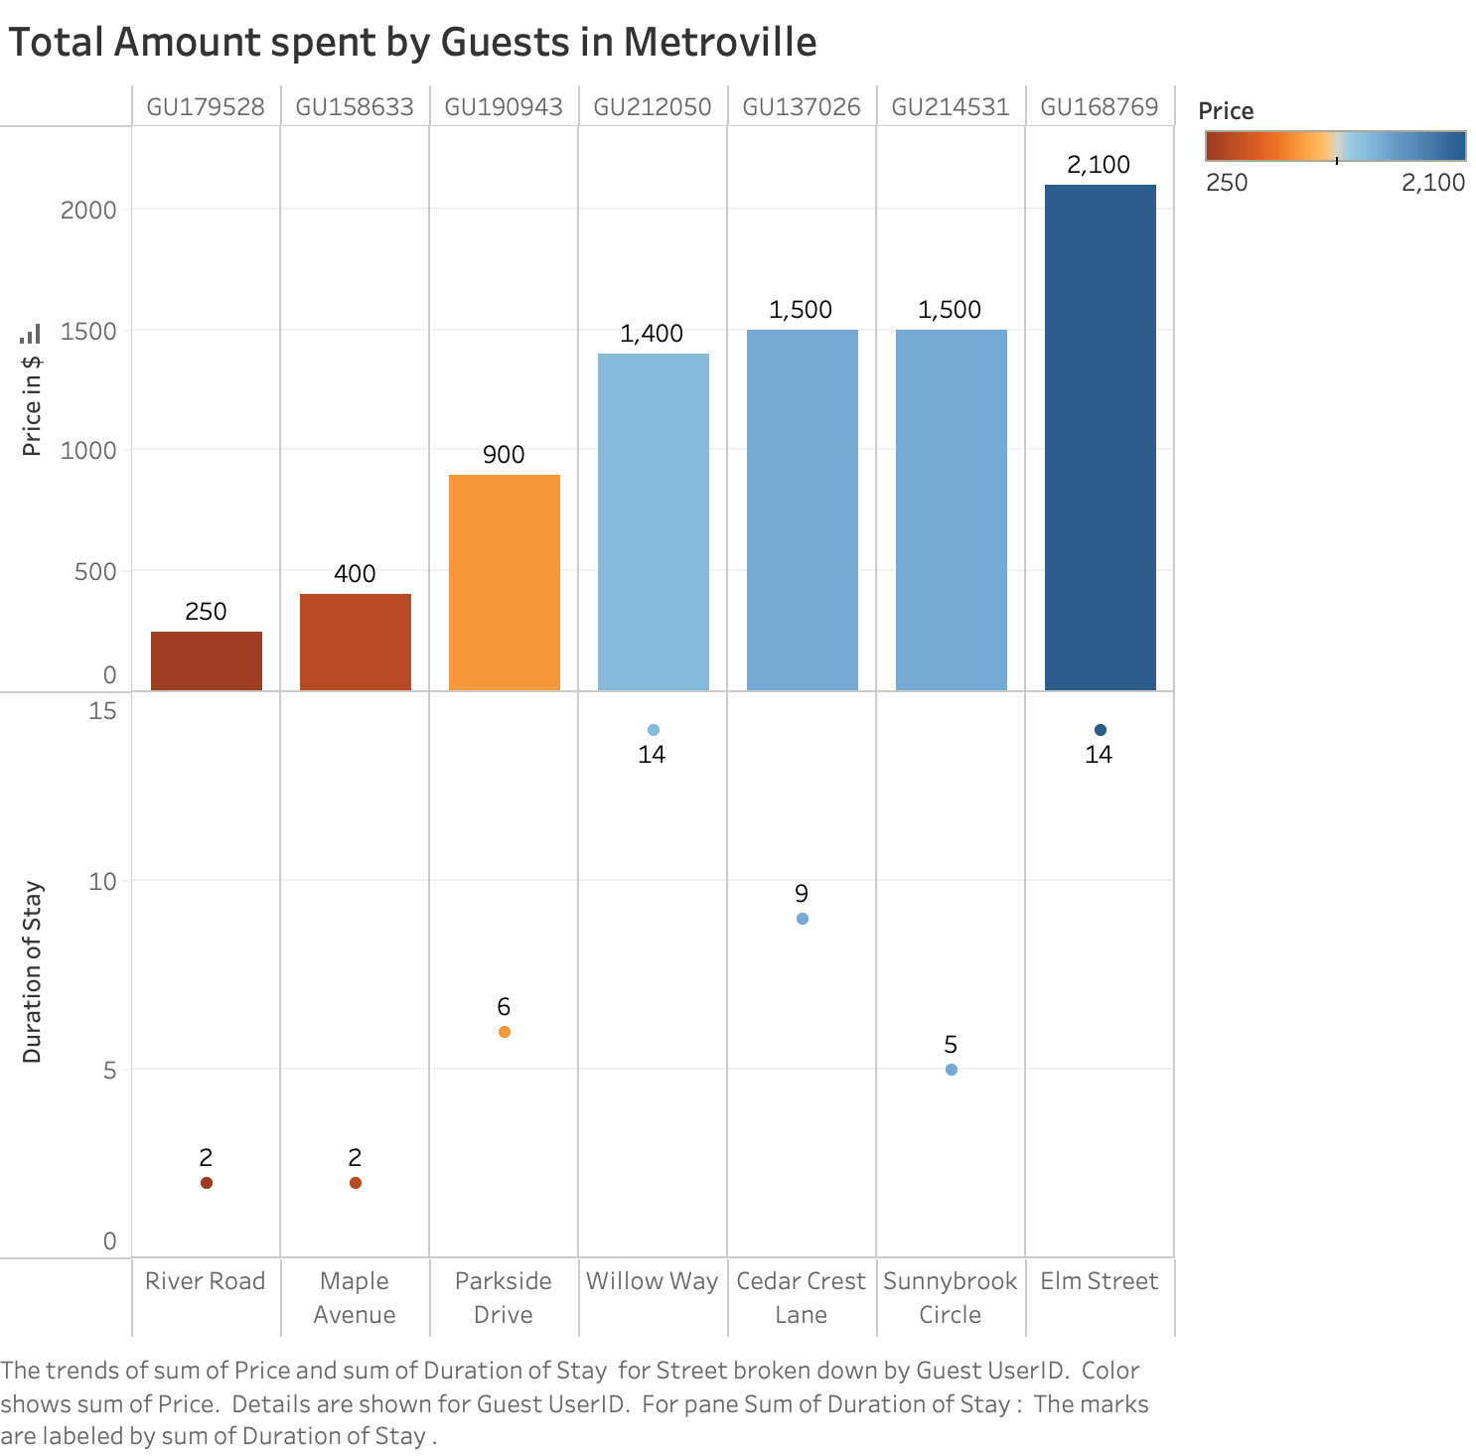

Slide 21
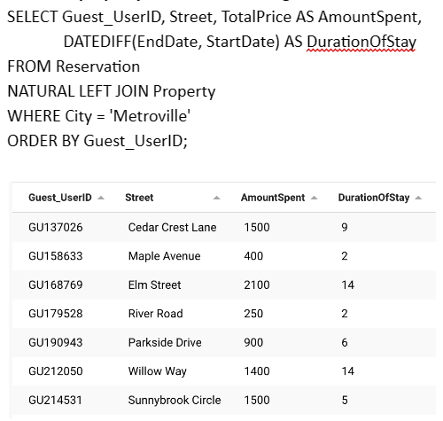
What are the total amounts spent and the durations of stay for each guest who has booked a property in Metroville, along with the street names of those properties?
SQL QUERY FOR VISUALIZATION
Query explanation:
This query is excellent for gaining insights into guest behavior in a specific city, Metroville. It provides information on the total amount spent, the duration of stay, and property location details. This aligns with your goal of gaining business insights and understanding user behavior.

Slide 22
Lessons Learned
Data Integrity
Flexibility
User Experience
The design ensures that data is consistent and accurate. For example, a reservation cannot exist without a guest and a listing.
New attributes or entities can be added without major changes to the existing structure.
By capturing feedback and ratings, the platform can offer better recommendations to future guests.
Better Decision Making
Business Insights
Operational Efficiency
Integrated data enables advanced analysis for data-driven decision making.
Analyzing the feedback can provide insights into the most popular listings or areas of improvement.
With clear relationships and attributes, operations like booking, payment, and feedback can be streamlined.

Slide 23

Conclusion
This design provides a comprehensive structure for a property booking platform, ensuring data integrity, flexibility, and enhanced user experience. It lays a strong foundation for building a robust and scalable system.

